Slide 1
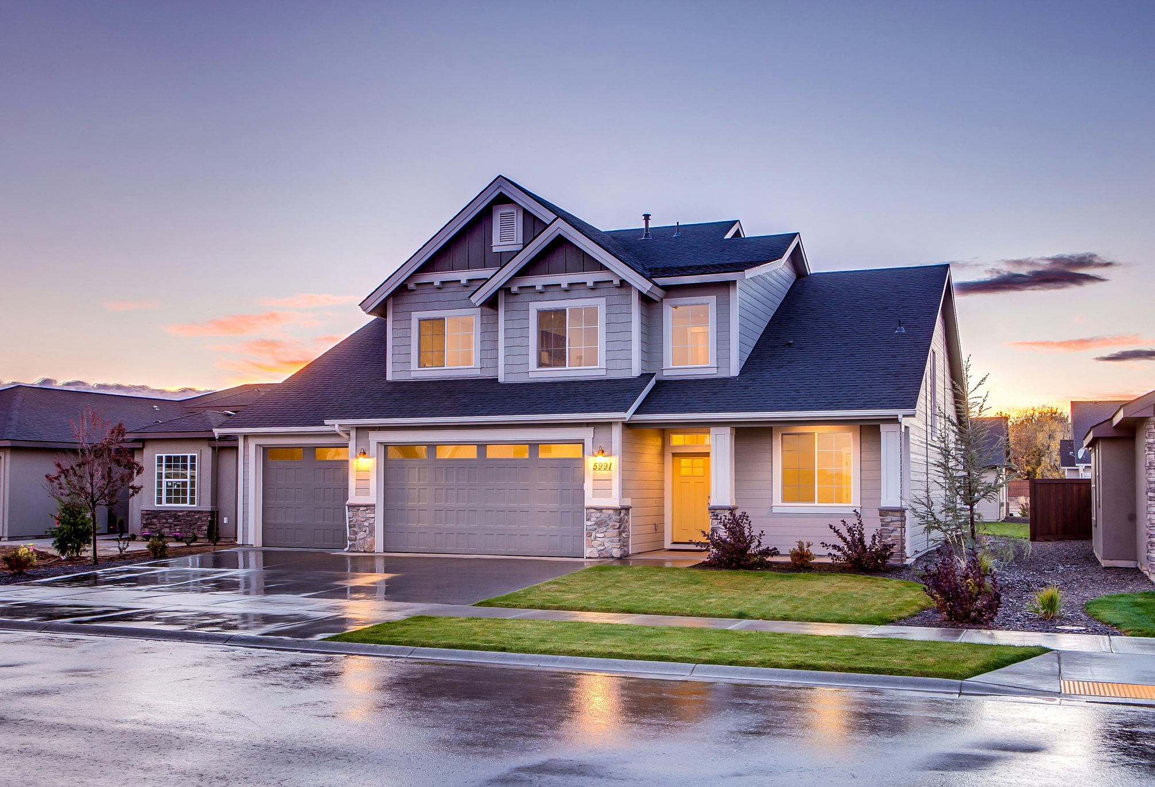


AMS GROUP
Home
About
Content
Others
LIVING+
A RENTAL SYSTEM
Members:
M. Sibtain 22i-0887
Abdullah Shakir 22i-1138
Maaz Khan 22i-2125

Slide 2

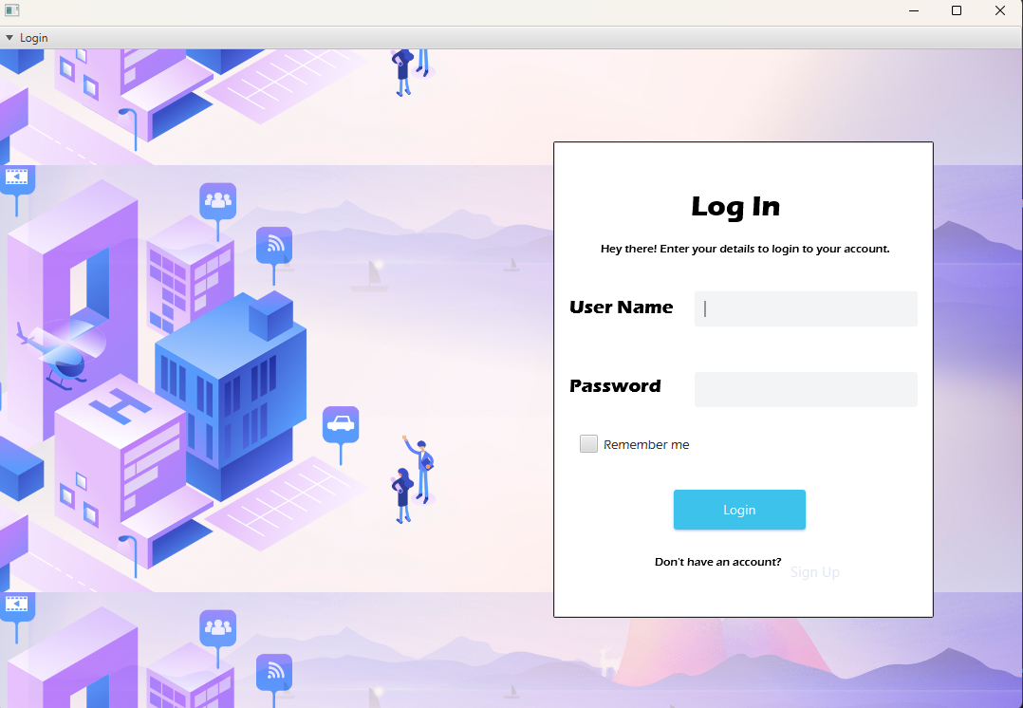
AMS Group
Home
About
Content
Others
PURPOSE
To provide a streamlined platform for hostel and
rental management, catering to users searching for accommodations and property
owners managing properties.
Target Audience:
Renters and property owners.

Slide 3

AMS GROUP
Home
About
Problem
Others
PROBLEM
STATEMENT
personalization
efficiency
dissatisfaction
Traditional accommodation systems lack personalization
Relies on manual processes or outdated methods that lead to errors
Lack of transparency, and limited control

Slide 4
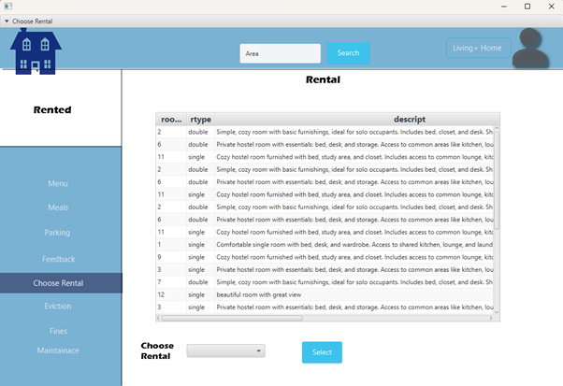
AMS GROUP
Home
About
Content
Others
USE CASE
Rent A Rental
Level: User-goal level
Primary Actor: Tenant
Preconditions: Rentals are available, and the tenant
has registered or logged into the system.
Stakeholders & Interests:
Hostel Owner: Needs to manage rental allocation and
tenant details.
Tenant: Wants to rent a rental in the hostel.

Slide 5
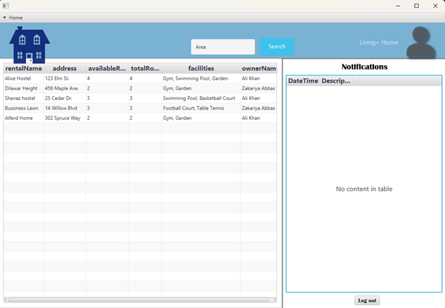
AMS GROUP
Home
About
Content
Others
MAIN SUCCESS
Scenario
Tenant
Tenant logs into the system.
Tenant searches for
available rentals.
Tenant selects a rental
to rent..
System
The system displays available rentals with details.
The system confirms the
selection and processes
the booking.
Owner is notified of the
new rental.
Extensions:
3a. If no rentals are available, the system informs the tenant and offers a waitlist option.
3b. If a room is not available, the owner offers another room.

Slide 6
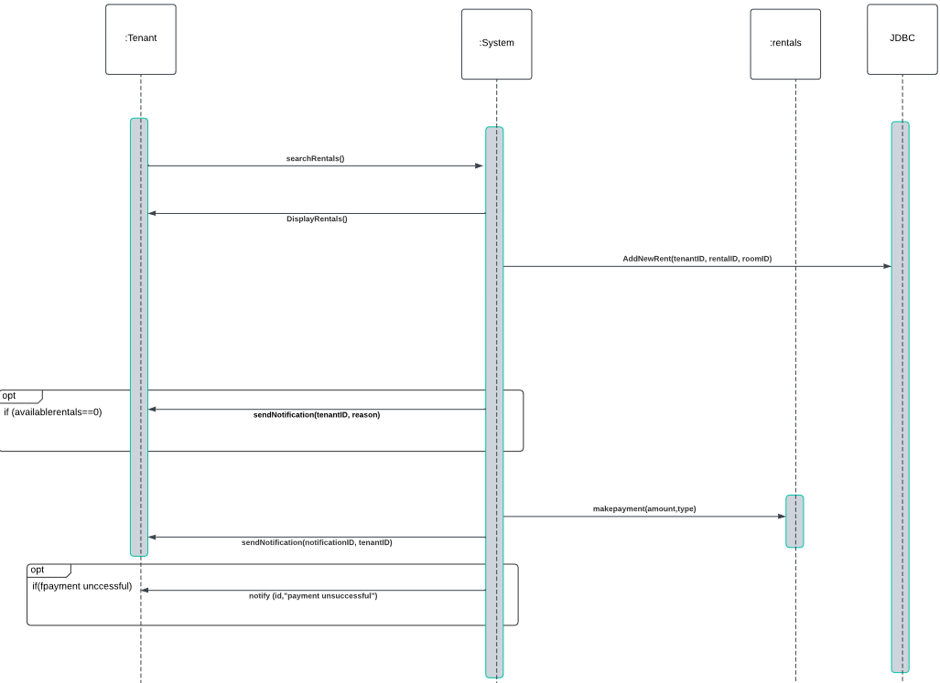
AMS GROUP
Home
About
Content
Others
Sequence
DIAGRAM

Slide 7

AMS GROUP
Home
About
Content
Others
Implementation
DETAILS
Libraries: JavaFX SDK, MySQL Connector/J.
Tables for users, properties, bookings, payments.
Localhost setup with MySQL.
Allows property owners to notify tenants of evictions through the system.

Slide 8
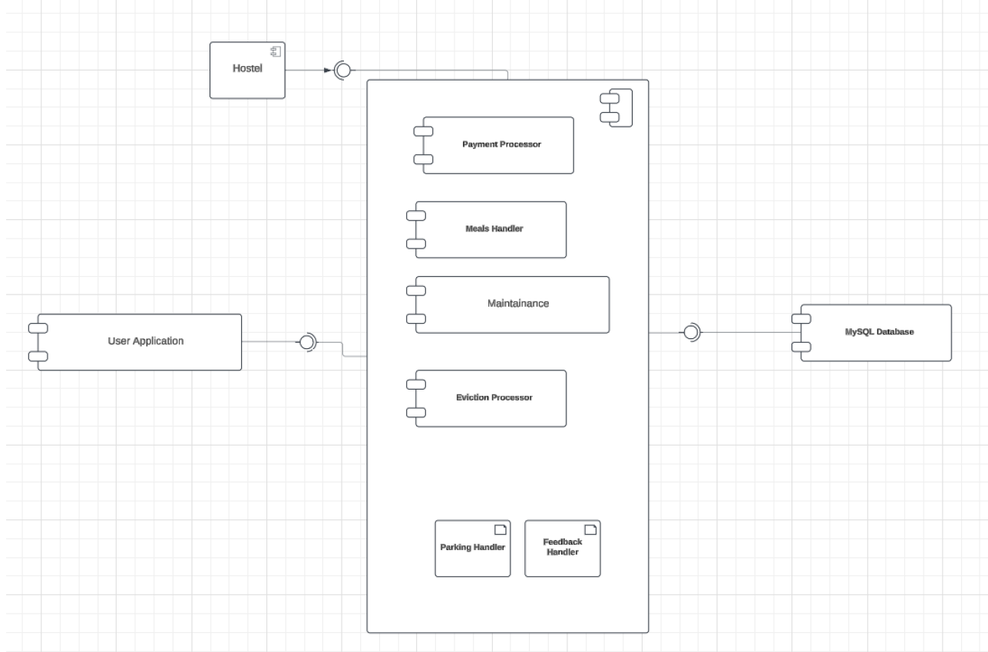
AMS GROUP
Home
About
Content
Others
SYSTEM
COMPONENTS
User Interface (UI Component)
Controller Layer
Data Access Object (DAO) Layer
Utility Component
Database Component

Slide 9
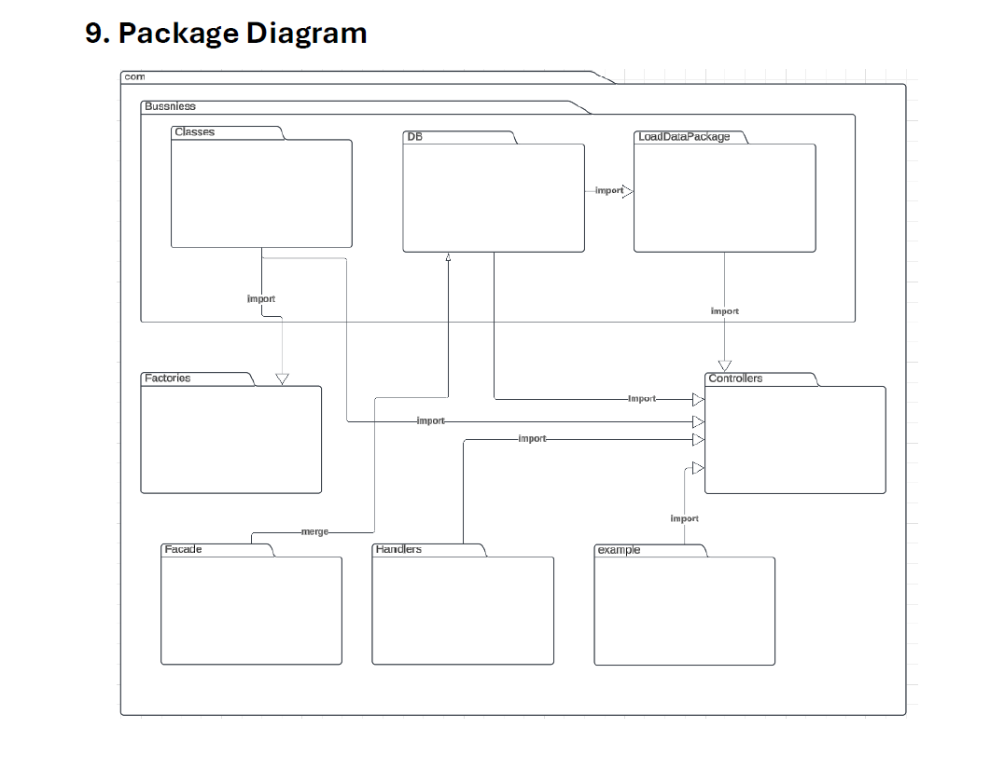
AMS GROUP
Home
About
Content
Others
SYSTEM
Package Diagram
com
Business
Classes
DB
LoadData
Factories
Handlers
Facade
example

Slide 10

AMS GROUP
Home
About
Content
Others
Challenges &
SOLUTIONS
Establishing reliable connection between the JavaFX application and the MySQL database.
Ensuring seamless user experience with minimal response times for search and booking operations.
Implementing auto notification for tenant notifications.

Slide 11
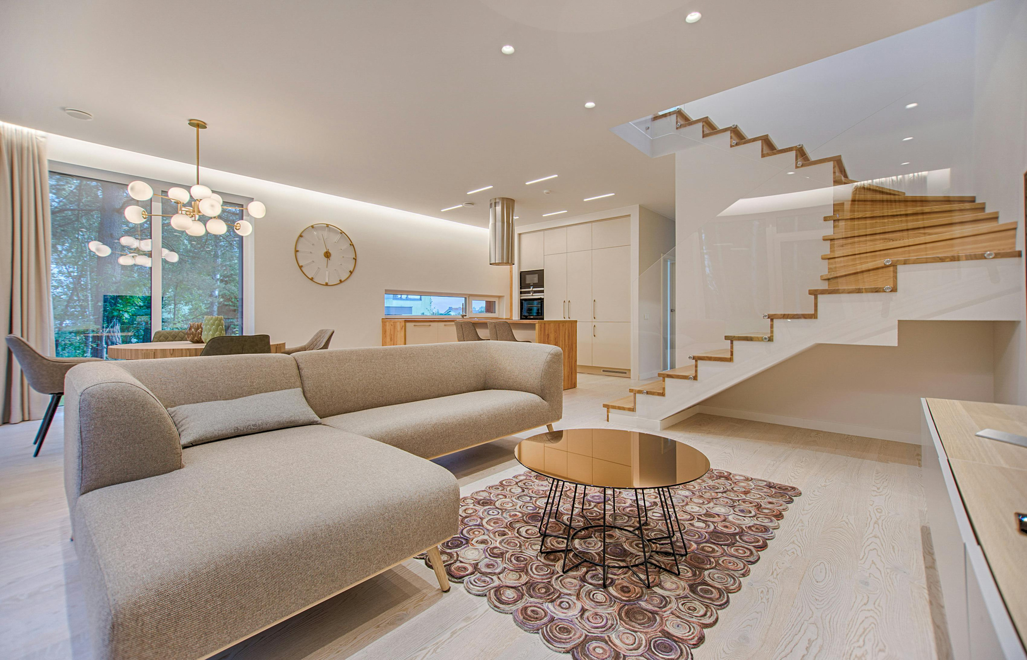
AMS GROUP
Home
About
Content
Others
THANK
YOU
-

